Slide 1

E-Books in HE Libraries -: Time for a quantum leap forward?
Jill Taylor-Roe
Head of Liaison & Academic Services
Newcastle University
STM E-book 2.03 Seminar
23 April 2009

Slide 2



Recent surveys suggest there is significant demand for /interest in e-books in UK HE
Spread of Responses:Exit Survey
Spread of Responses:Entrance Survey

Slide 3
It’s not just librarians who are interested…
“Originally the driving force was library staff as we experimented with ‘new’ technology and looked for ways to support increasing numbers of part-time and distance learners. We were lucky that our students embraced them enthusiastically. Now , as with journals, more and more students are demanding text books electronically and can’t understand why some are not available”
“Subject areas with good e-journal access, especially STM are also beginning to enquire as they appreciate the convenience of 24/7 access”

Slide 4
It’s not just librarians who are interested…
“Pressure to buy e-books is coming from students, satisfaction survey indicate demand, along with consistent demand for print”
“More recently demand is being generated form teaching staff as more use is being made of VLE’s and the requirement to be able to directly link from the VLE or online course to the e-version of a text”

Slide 5
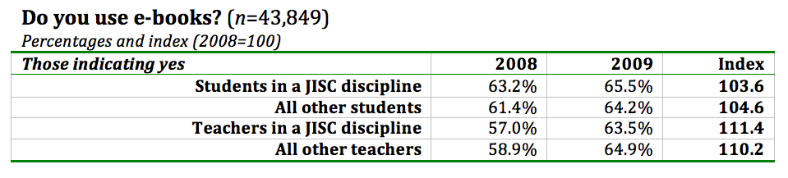
Pushing at an open door…
More than 60% of the academic population is already using e-books for work or leisure
More people are using e-books: with a large increase among JISC teachers, perhaps as a result of intense promotional activity?
Slide 5
Notes:
JISC E-books UK Roadshow
5

Slide 6
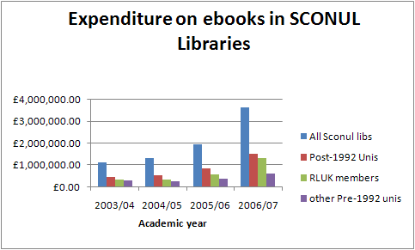

But how is this translated into actual spending?
Source: Annual SCONUL statistics

Slide 7
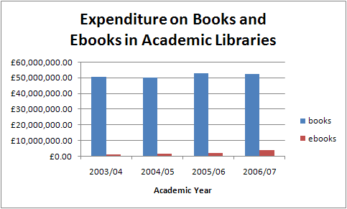
Ebook expenditure is still only a fraction of print book spend
Source: Annual SCONUL statistics

Slide 8
Why UK higher education has not bought more ebooks
E-book pricing models are not satisfactory (64%)
There is too little choice of e-book titles (62%)
E-book access models are not satisfactory (53%)
We are waiting for the market to settle down (33%)
We are waiting for JISC Collections to offer better e-book deals (30%)
E-books are too expensive (28%)
I do not know what is available (18%)
There is no demand for e-books here (13%)
Affiliated/ external users are not allowed access (11%)
The technology is too complicated (8%)

Slide 9
Business Models: findings of the Observatory project
There is no one model that fits all universities
  Librarian entrance survey showed that most universities do not have separate e-book budgets but it does vary. Also the spend on e-books varies dramatically from £200 to £100,000
  Librarian exit survey asked what the most appropriate business models is. There was a slight preference for in perpetuity over subscription with credit systems not always seen as favourable (although some love it!), so no real consensus
  BUT
Everyone wants
  Consistency
  Unlimited simultaneous access
  No embargoes on new editions
  Flexibility to pick the titles you want – no bundles
  MARC records
  DRM that accounts for real user behaviour!

Slide 10
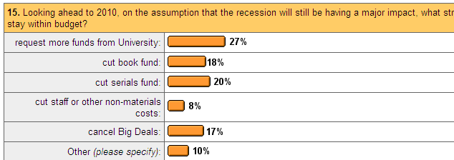
How are Librarians responding to the current budget shortfall, this year and next?
(< from 23%)
(> from 12%)
(> from 4%)
(< from 23%)

Slide 11
Usage Data…
“Although the majority of statistics are COUNTER compliant, some librarians perceive that this adds little to their value, and may not help with comparisons across platforms due to the disparate COUNTER reports used by different publishers / e-book aggregators”

Slide 12
E-book collection – subscription model (COUNTER compliant stats)

Slide 13
Individual title – subscription model – n.b. stats not COUNTER compliant

Slide 14
How do users want to access e-books?
Will users want to use them via their own equipment – iphones, iliad, kindle etc?
Should the library buy e-book readers and loan them out as we do laptops?
If so which ones should we buy?

Slide 15
Where do we go from here??
Libraries still feel they are not getting access to enough of the e-books they want to buy
Users are interested in ebks and increasingly comfortable with using them.
JISC Observatory project has exploded myth about library ebk sales damaging print sales
Time is ripe for publishers to come up with new and sustainable business models for library e-book sales

Slide 16
Help is at hand! : New from JISC
A study on the management and economic impact of e-textbook business models on publishers, e-book aggregators and universities
Aim is to create realistic, simple and sustainable business models using real data from a range of access models
Reviewed the current e-textbook business model landscape
Selected a variety a trials following consultation with a range of stakeholders
Will include the ‘crown jewel’ e-textbooks
The trials will take place over a full academic year
The impacts on print sales, time and resource will be measured
Take account of the uneven and non-linear use

